Slide 1


The Imperial College Tissue Bank
A searchable catalogue for tissues, research projects and data outcomes
Prof Gerry Thomas - Dept. Surgery & Cancer
The Bioinformatics Support Service
- Dept. Life Sciences
Contact: geraldine.thomas@imperial.ac.uk
s.butcher@imperial.ac.uk
www.imperial.ac.uk/bioinfsupport

Slide 2
Background #1
Tissue bank infrastructure (ICHTB) allows staff to collect diverse biological material from patients treated within Imperial NHS Trust www.imperial.ac.uk/tissuebank
Also hosts a large number of epidemiological cohort studies that are of international importance e.g. Chernobyl Tissue Bank www.chernobyltissuebank.org
Contains over 58,000 samples from over 15,000 different patients
To date 23,000 samples issued to researchers
Used in 433 different research studies

Slide 3
Background #2
All studies have appropriate ethics approvals and where appropriate, Caldicott Guardian agreement
Information held about the donors, who have to give consent for their tissue to be held, is anonymized at source in accordance with the Human Tissue act
ICHTB is the first UK tissue bank to be granted approval to link its data on specimens with data from the English National Cancer Registry – patient outcomes
Role-based access to underlying database with secure web-based interfaces

Slide 4
Existing Workflow
Tissue bank staff record information on specimens, operations and donors
Separate interface allows researchers to search database for biological samples useful for their research
Request made to use specific samples in a research study (funded by diverse means incl. RCUK, charities) Once approved, samples issued for research
Data are generated from the samples in a variety of ways – and are subject to funders’ data sharing policies
Data are also of use to future research particularly since samples are irreplaceable

Slide 5
Objectives
Extend the tissue bank infrastructure to offer a searchable data catalogue for research data arising from tissue bank samples
Data repository for key datasets not already submitted to public repositories, also derived/analysed data formats of particular interest
Tie to funding information – grant codes, project title
Bring together stable accession numbers for data stored in public repositories, access to ‘locally stored dark data’, publications, summaries, SOPs
Deposition to data catalogue becomes requirement of accessing any tissue samples

Slide 6
Exemplar exists in the smaller Chernobyl Tissue Bank
Some of this software infrastructure can be repurposed
Uses community metadata standards where they exist (see http://mibbi.sourceforge.net/portal.shtml)
Also link to associated publications
We maintain a number of existing specialised data repositories e.g. OMERO for imaging that could be linked
We frequently work with the common public data repositories and are very familiar with their requirements/formats/metadata

Slide 7
Challenges
MULTIPLE - sample types, study types per sample, data types per study
MULTIPLE - bio-data file formats, metadata standards, public repositories
data in public repositories may itself be held behind ethics/privacy panel
SO – this prototype will provide specialised data upload templates for key data types initially

Slide 8
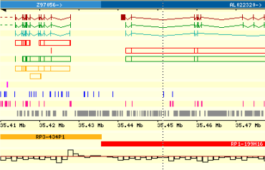

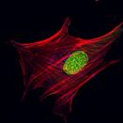
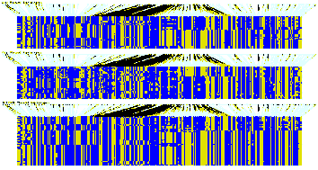
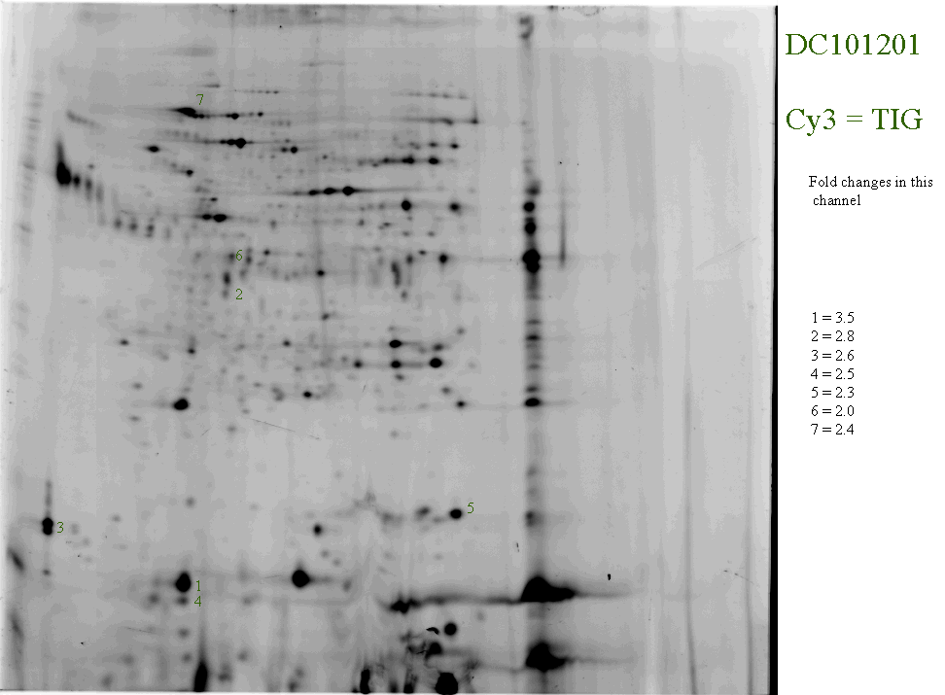
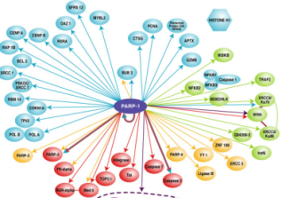
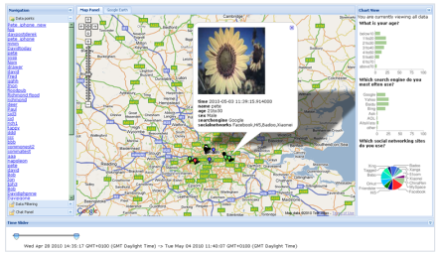
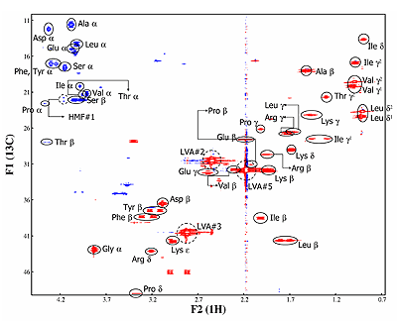
Many Data Areas
RNA profiles
Genome sequencing
imaging
Improved understanding
of complex biological system
Challenges in primary analyses (smaller) AND in meaningful integration (huge)
GWAS
Protein profiles
Protein interaction
studies
Large-scale field studies
Metabolic profiles
Notes:
Challenges in each dataset – generate, store and analyse
Major challenge in making sense of multiple datasets - meaningful integration

Slide 9

Bio-Data Standards
30+ minimum reporting guidelines for diverse areas of biological and biomedical data
Few cross experimental types – confusion, fragmentation
Differing levels of use and maturity
‘Minimum’ can still be huge – ‘just enough’ movement
Multiple standard formats for reporting e.g. MAGE-ML
Not always easy to find associated tools to help use
http://mibbi.sourceforge.net/portal.shtml

Slide 10
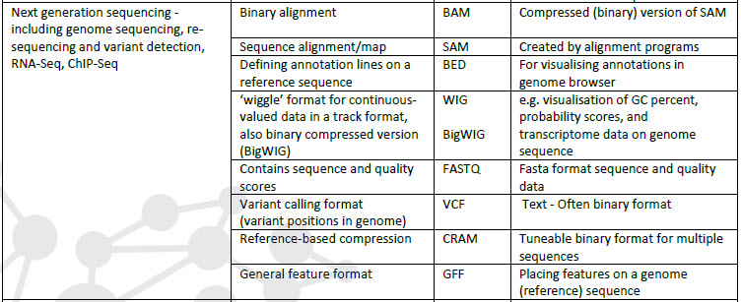
Data Formats
Even for one experimental type, many file formats
may be human readable, require require specific software, proprietary or open source….. and Excel spreadsheets
Notes:
But many experimental types

Slide 11
Public Repositories
NAR online Molecular Biology Database Collection http://www.oxfordjournals.org/nar/database/c/ currently 1552 databases
Limited by data domain or origin or both
One project may require data submission to >1
May cross-reference data-sets across databases
Each has its own format and metadata requirements
Some are manually curated, many are not
Data submission may be a requirement for journal publication

Slide 12

Example -
(Example)
http://www.ebi.ac.uk/ena/home since 1980
Genes, genomes (assembled sequences), raw DNA sequence, annotations
3 reporting standards of its own, 5 community-based minimum reporting standards
Has own XML-based submission system
Large datasets can take weeks to prepare/validate and generate 100’s of thousands of lines of XML, TB
Stable accession numbers and versioning
Can protect submissions behind embargo and/or ethics panels (EGPA)

Slide 13
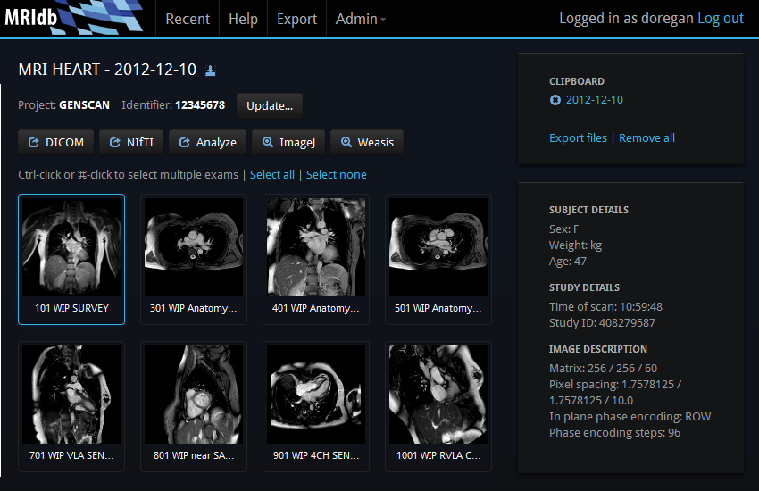
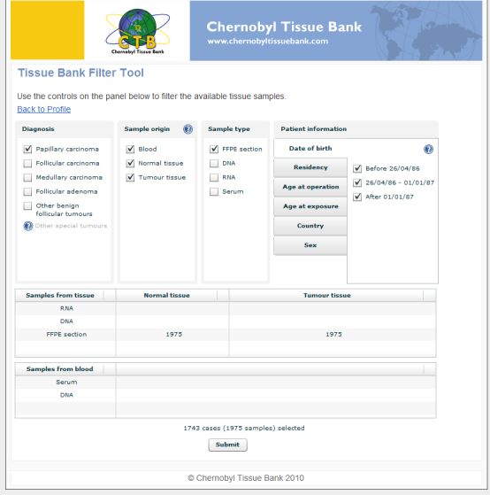
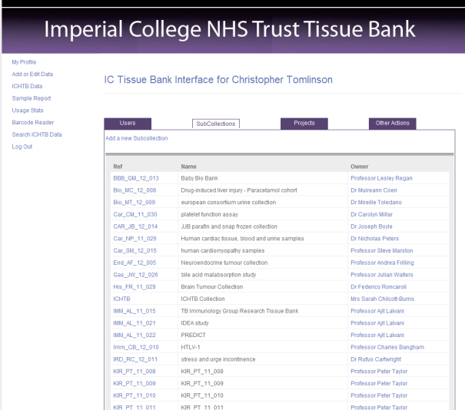
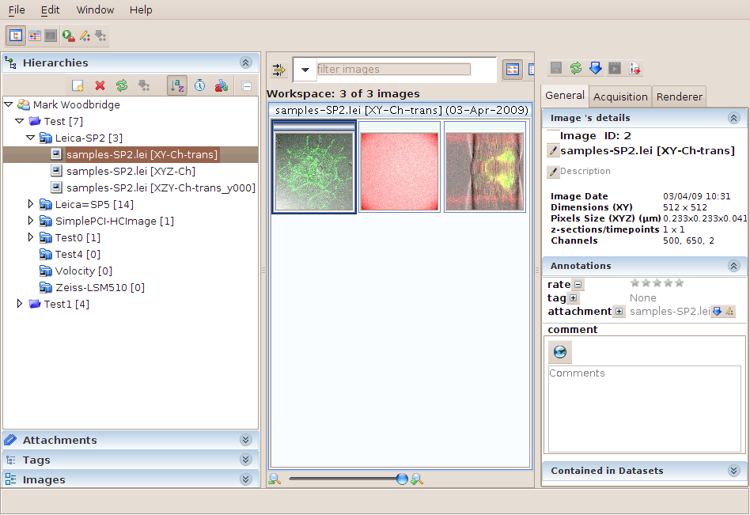
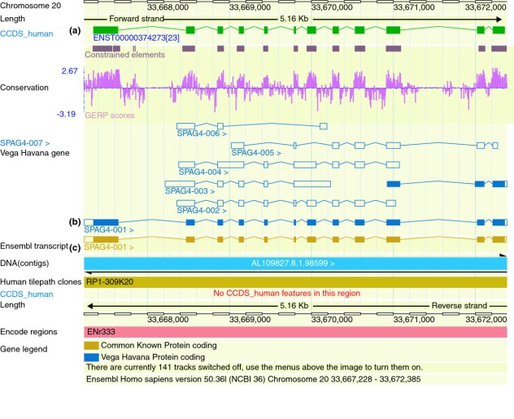


Specialised Local Repositories
MRIdb
Chernobyl Tissue Bank IC Tissue Bank
OMERO

Slide 14
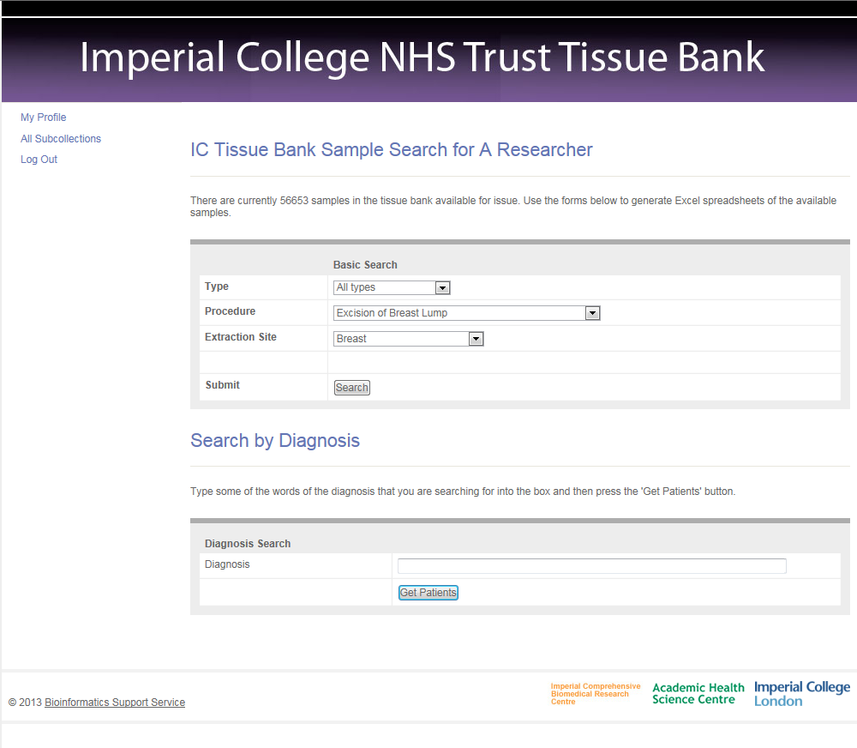

Slide 15
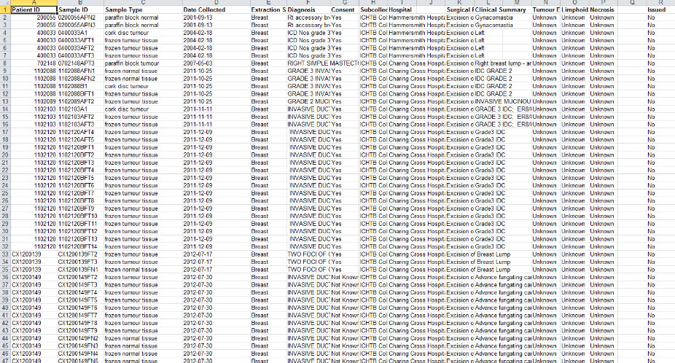

Slide 16
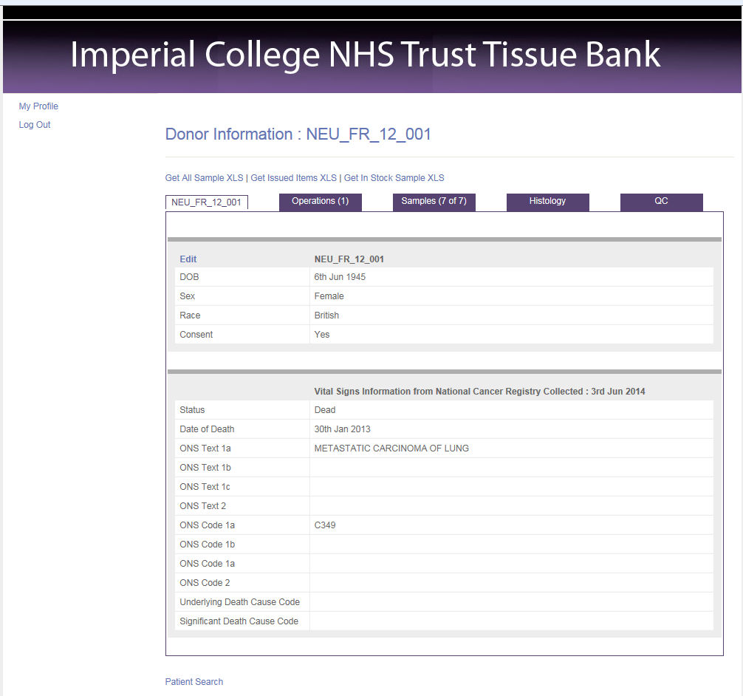

Slide 17
